Slide 1
Document Model

Slide 2
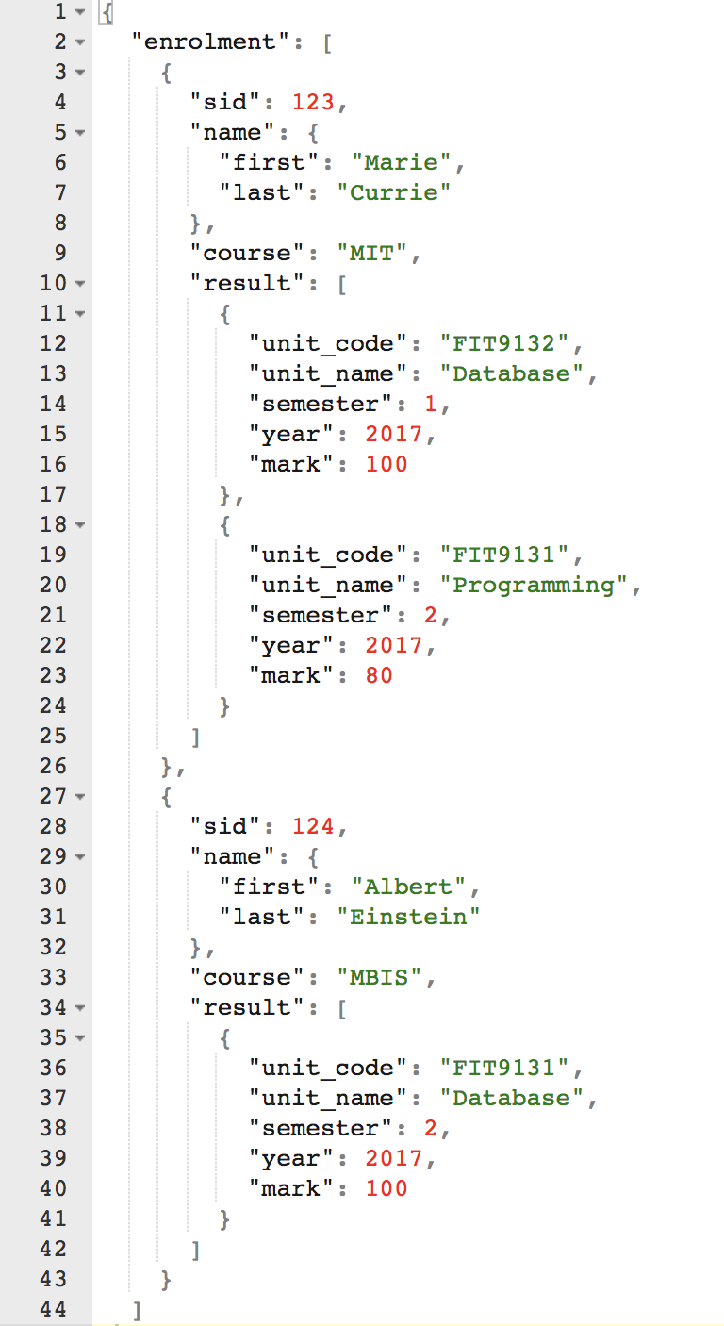
Document Data Model
sid | sfirstname | slastname
123 | Marie | Currie
124 | Albert | Einstein
ucode | uname
FIT9132 | Database
FIT9131 | Programming
sid | ucode | year | semester | mark
123 | FIT9132 | 2017 | 1 | 100
123 | FIIT9131 | 2017 | 2 | 80
124 | FIT9131 | 2017 | 2 | 100

Slide 3
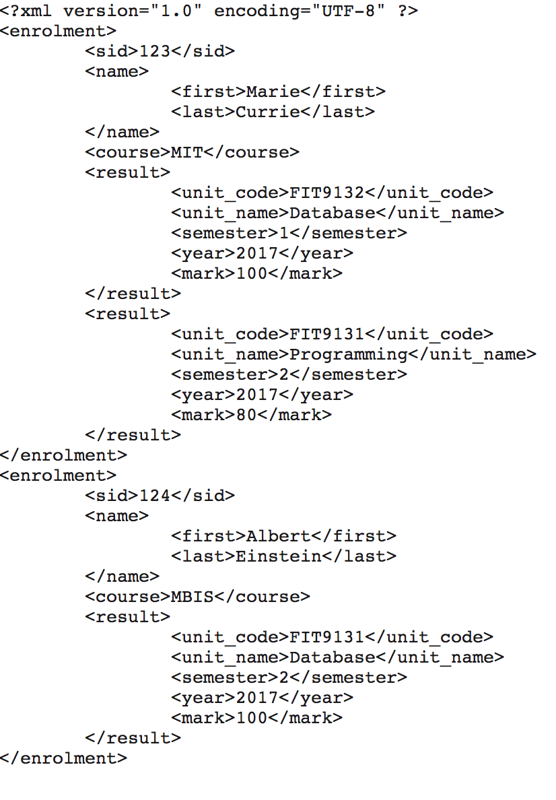
Document Data Model
JSON
XML

Slide 4
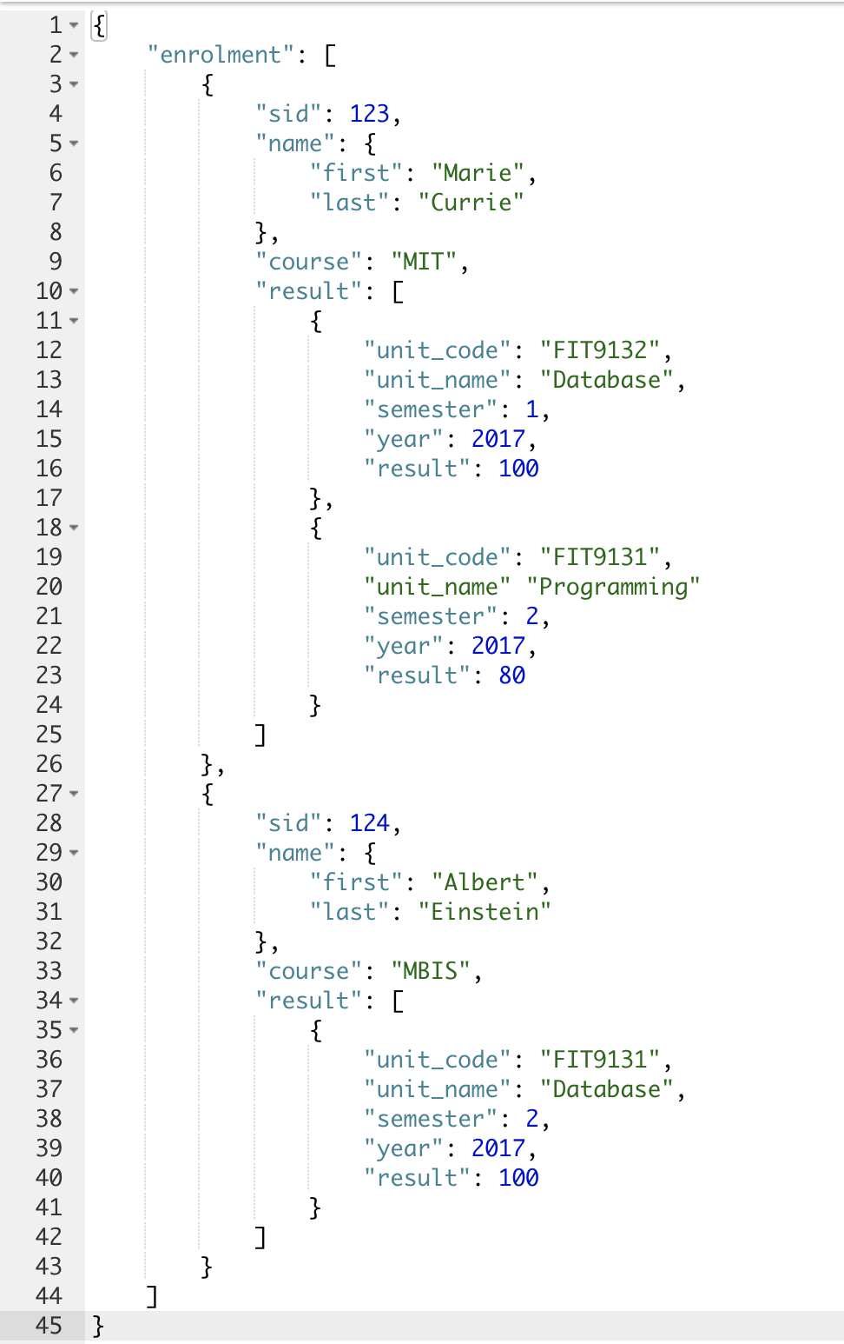
JSON data model
Terminologies
Object
Members
Pair
Value
Array
Elements
The object NAME has members (two pairs).
The object ENROLMENT is an ARRAY.
The elements of this ARRAY are STUDENT objects
The object SID is a pair of a string “SID” and a value “123”.
JSON.org

Slide 5
JSON Object vs Array
Object:
Unordered list.
List 1 {a,b,c,d} = List 2 {b,c,a,d}
Accessed by its name.
Array:
Ordered list
List 1 {a,b,c,d} <> List 2 {b,c,a,d}
Can be accessed by its position.

Slide 6
JSON data type
String
Number
Object
Array
True
False
NULL

